Slide 1
Least-squares, Bayesian Est., Monte-Carlo Diagnostics,
Seq. & Inf. Stat.,
PSD, Stat. Dist. Measures
Estimation Techniques for Internal Variables
Sequential Monte Carlo for Non-Linear, Non-Gaussian Systems
Missing Data, Big-Data Analysis, Digital Twins
Fault Detection & Diagnosis/Isolation/
Review of Lecture 1-4 :
A Re-Look on What & Why
we need to Learn
Sys.Struc.Eqpt(SSE)
Maintainability
Testability
Repairability
Plant/Industry
Availability
Productivity
Profitability
ODEs/PDEs, Transforms,
Transfer Fns., Discretization, Freq. Domain;
Multi-Variate Data Analysis
Simulation Models of SSEs ( Static & Dynamic Models)
Tweaking of Parameters & Variables in SSE Models
Simulation of Transient & Steady-state Characteristics of SSEs
Statistical Models for System Uncertainties & Measurement Noise
SSE I/P-O/P Dynamics
Quantitative Models
ODEs/PDEs/Difference Eqns
Matrix/Vector Models
Tree-based, Relationship based, Graphical Understanding, Interpretation from Limited Measurements
Fault Tree Analysis (Reliability Models, Failure Models, Test-data)
Selected Measurements at Specific Nodes of SSE
Signatures of Output Signals (Graphical, Spectral, etc.)
Preliminary Statistical Relations (Mean, Variance, Correlation, etc.)
SSE I/P-O/P Relationships
Qualitative Models
Governing Dynamics
Key Parameter Indictors
Graphical Relationships
Qualitative, Logical, Rule-based, Digraphs, Basic Data Processing & Sys. /Eqpt. Behaviour Anal.
Parameters, Internal Variables, Measured Variables, Disturbances,
Maintenance Methodologies/ Paradigms
Digraphs/Records/Performance Charts/Manual Data Processing
Preliminary Analytic Tools/ Non-Parametric System Identification from Data
Maintenance Automation Planning Requirements for Industrial SSEs

Slide 2
Acknowledgement Internet Images, available in Public Domain, have been used in many Slides of this Presentation. Some of the Images have also been Modified/Superimposed. Used only for Academic Purpose/Understanding.
Lecture-5
Takeaways :
Understanding Impulse, Step & Ramp Functions (use of Laplace Transforms)
The Concept of a Transfer Function to Understand System Dynamics – the Concept of Poles & Zeros
The Concept of Feedback and Closed Loop Dynamical Systems
Understanding Transient Characteristics of Dynamical Systems
Discretization for Digital Control --- Introduction to the Concept of z-transforms
Understanding System Type (from Transfer Functions) and Steady State Errors
Determining Time Constants of Systems & Equipment, as a Maintenance Management Tool

Slide 3
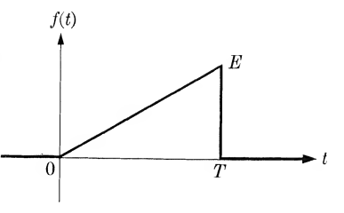
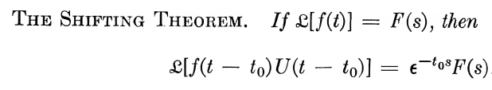
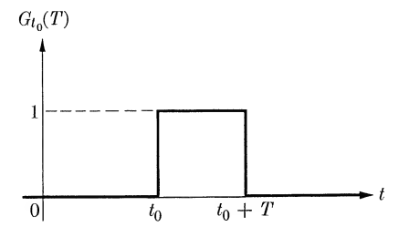
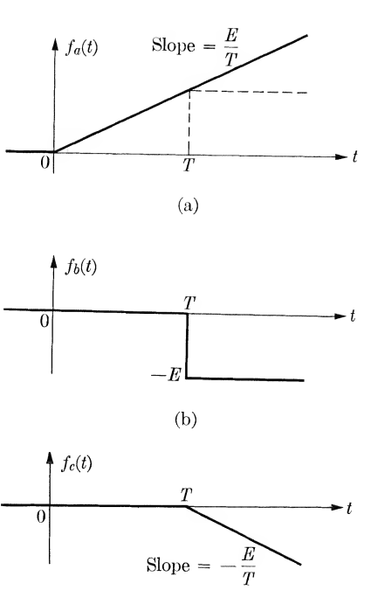

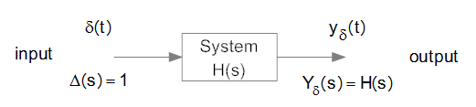
Some Important Concepts while using Laplace Transforms

Slide 4
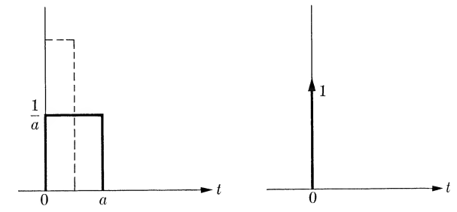
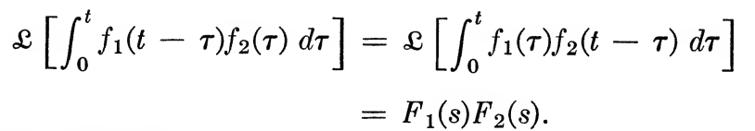


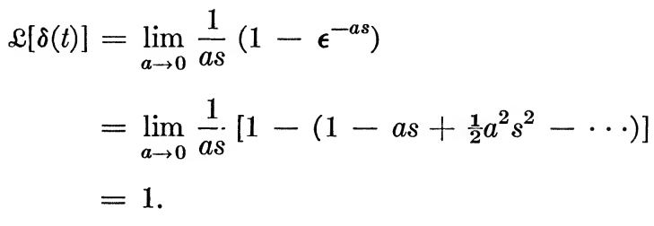

Impulse Response

Slide 5
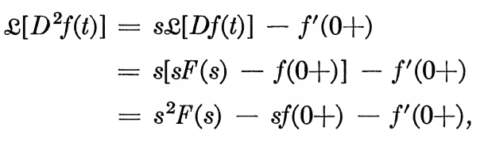
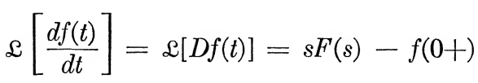
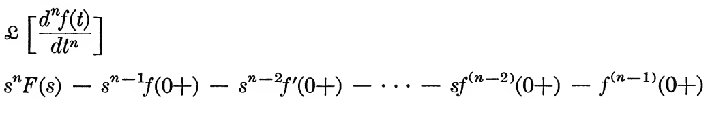
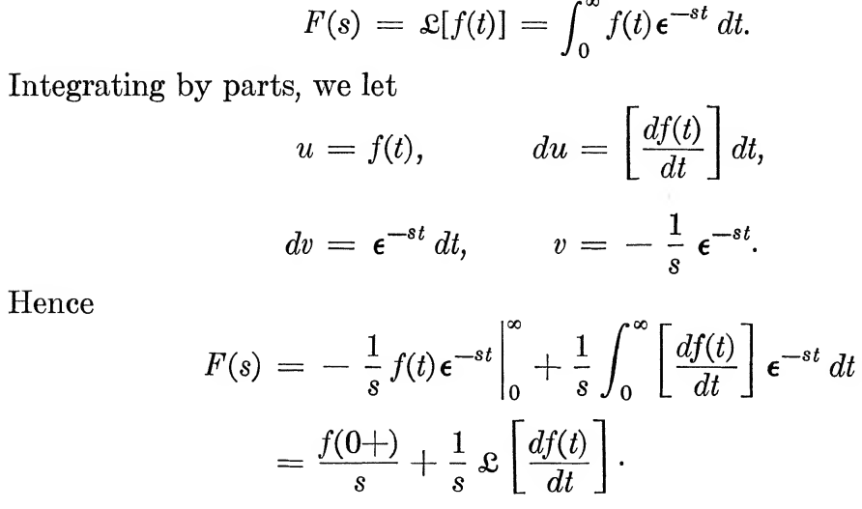


Slide 6
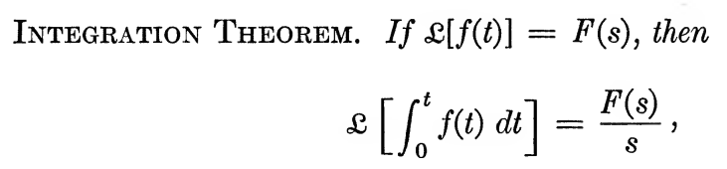

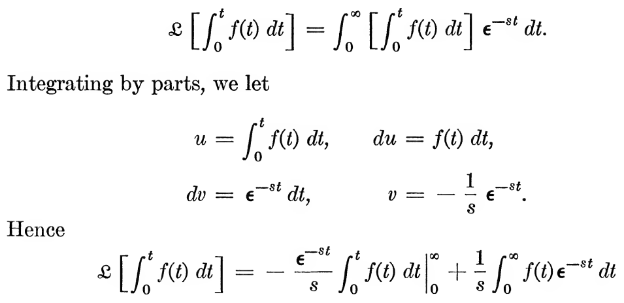
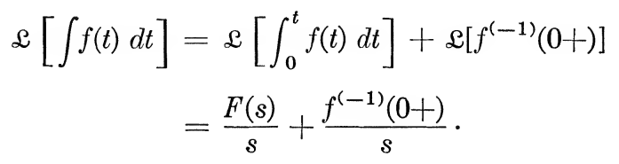


Slide 7




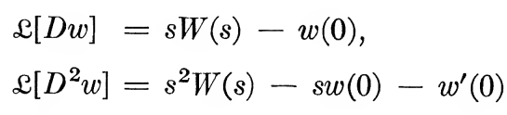

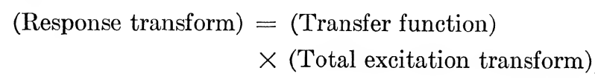

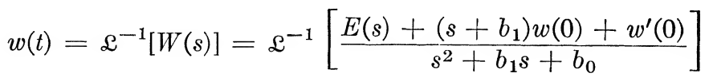

Slide 8



An Understanding of System Dynamics
Proper Rational Polynomial Fractions
System Type --- No. of Free Poles / Integrators

Slide 9
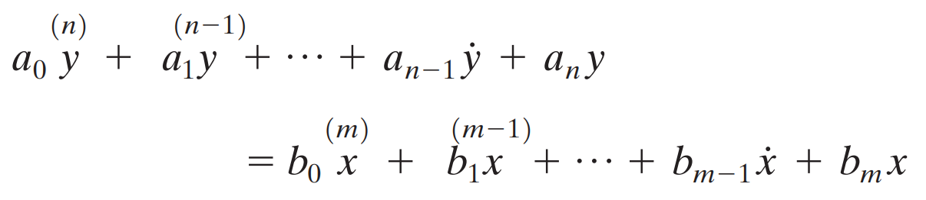
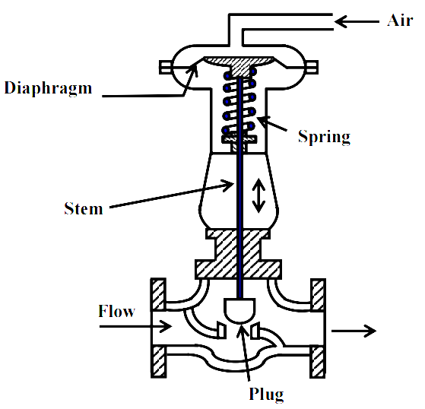
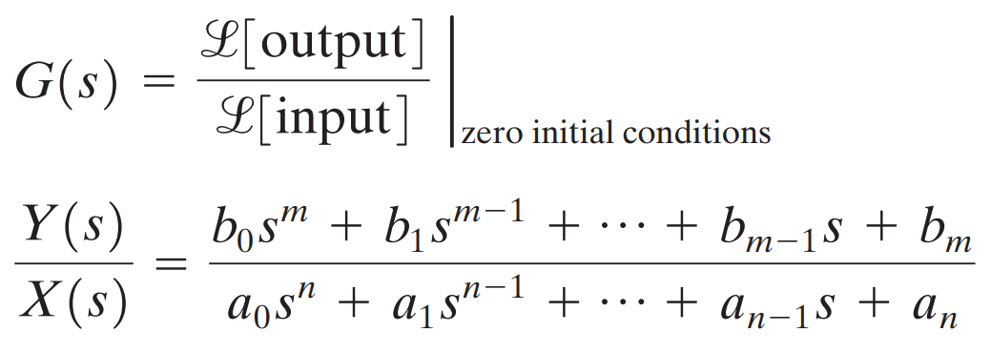
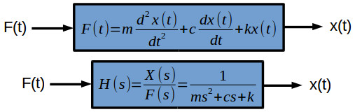
Building a Transfer Function

Slide 10
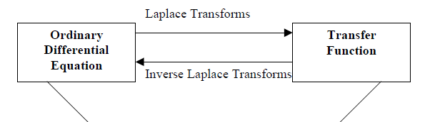
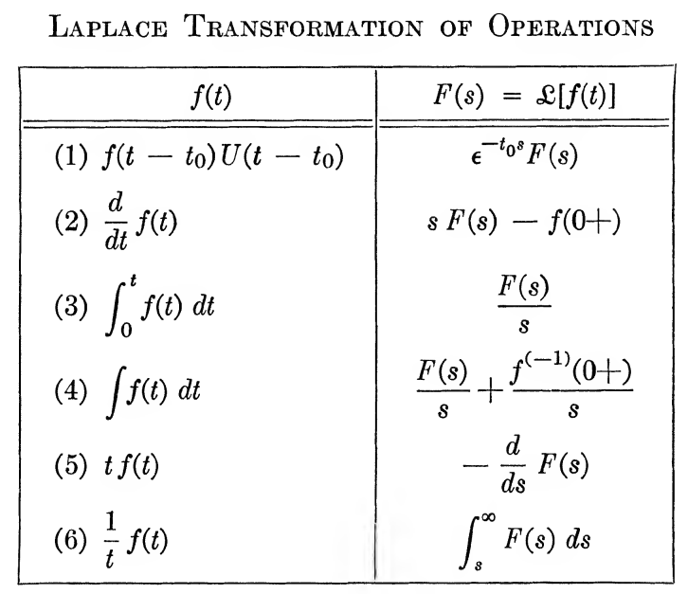
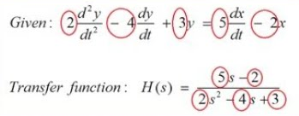
Differential Equations to Transfer Functions

